Slide 1
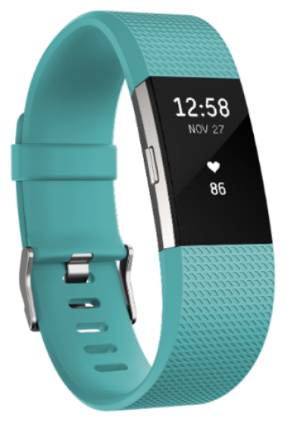
Fitbit-X
IEOR 135: Applied Data Science with Venture Applications
Team 34:
Adele Bloch, Sarah Cook, Daniel Hwang, Kelley Liu, Wilson Tam
Notes:
Problem that you are solving with your code/project
Approach that you took to solve the problem and your final state or results.
Architecture of solution
Intended user interface
Summarize the learning path: From where did you start in terms of basic understanding, how did you get to the solution, what ideas did you try first, what else did you try, in what order, what experiments did you try to test, etc.

Slide 2
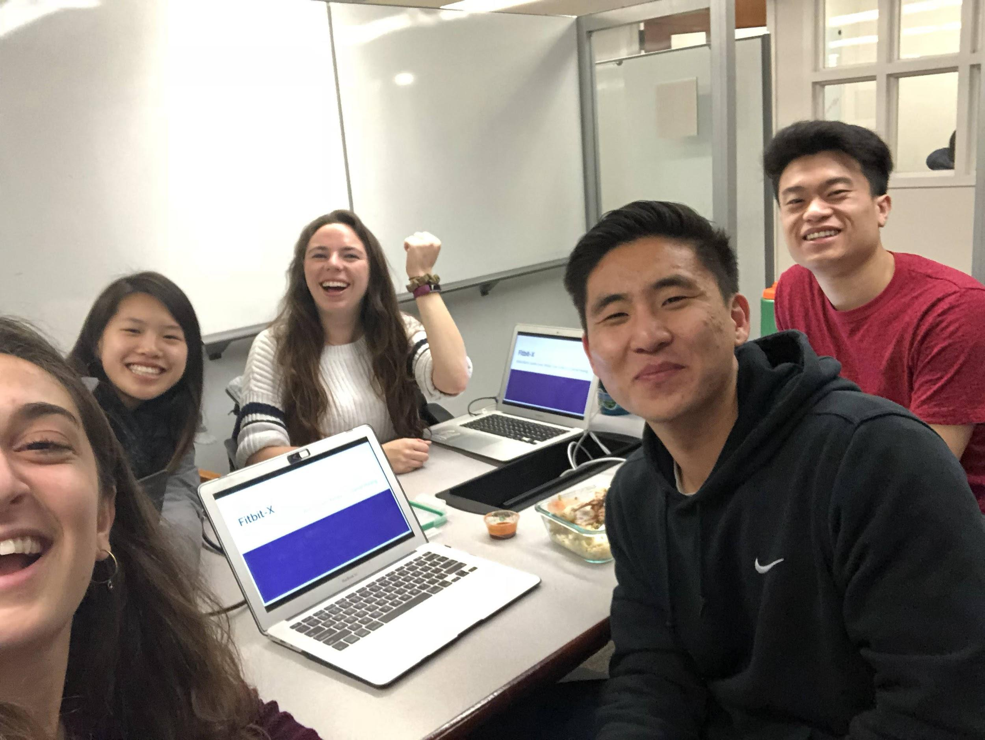
Meet the Team

Slide 3
The Problem

Slide 4
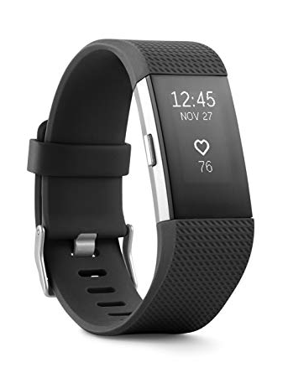
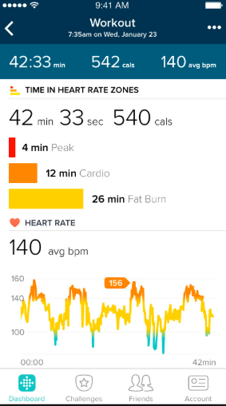
Problem
Millions of health-care data points are collected by Fitbit every day, but Fitbit only offers a limited scope of insights.
Goal
Create a website where users can upload their Fitbit data and receive further trends and insights that can help them meet their fitness and health goals.
Notes:
adele

Slide 5
The Solution

Slide 6
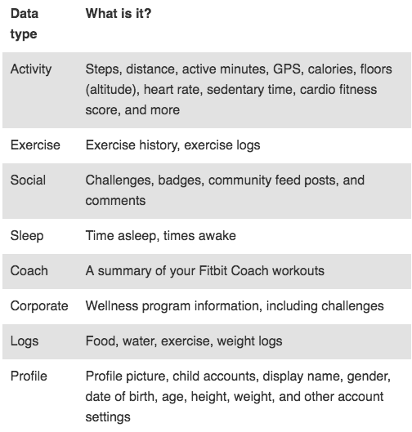
Users can download data from Fitbit
Notes:
adele

Slide 7
An Architecture
Clean the data
User uploads Fitbit data to website
Interactive user interface
(Flask)
Exploratory data analysis
(Python, Pandas)
Healthier, happier Fitbit users
Visualizations
(Seaborn, Matplotlib, Chart.js)
Notes:
adele

Slide 8
Approach

Slide 9
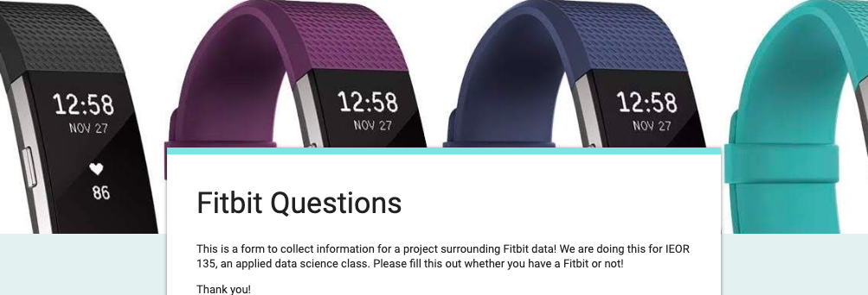
Validating the idea
Ran a survey to Fitbit and smart watch users
Of the Fitbit users we surveyed, 86% of users were interested in such a project
Notes:
We are going to give you a high level overview of our strategy, and then dive into the actual code of it at the end with a demonstration.

Slide 10
Working with the data
Data comes in CSV and JSON files
CSV files - more limited data, easier to work with
JSON files - more advanced data, harder to work with
Began cleaning and analysis on CSV files, while simultaneously writing code to compile over 1,500 JSON files
Once we compiled the JSON, we cleaned and then performed EDA on all files
Notes:
kelley

Slide 11
Creating a platform for our solution
Wanted to giver Fitbit users a platform to display visualizations from their Fitbits that were not already provided in the app
Used Jupyter Notebooks to run the data cleaning and EDA process and at the same time created a website using Flask as the backend
Notes:
kelley

Slide 12
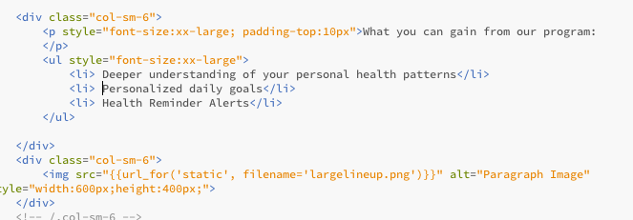
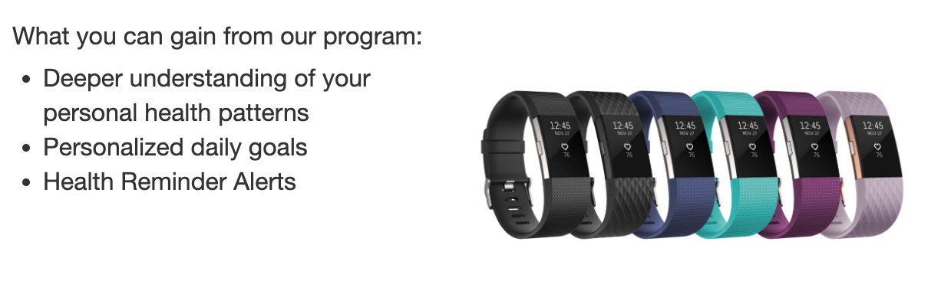
Flask Website
Our team has zero web development experience!
Why Flask?
Plethora of online resources
Python compatible
Website Creation Process
Basic templates
File structures
Uploading files
Difficulties with graphing
Notes:
Sarah

Slide 13
Challenges we faced

Slide 14
Challenges we faced
Development of the Website Interface
Team had zero full stack experience
Zero Javascript and HTML experience
Runtime due to fine granularity of data points
Notes:
wilson

Slide 15
Next steps

Slide 16
Future Opportunities
Create Machine Learning Models
Improve Run Time of Current Code
Improve Website Functionality
Sell to Fitbit!
Notes:
daniel

Slide 17
Demonstration
Notes:
Final cleaned df - kelley csv, wilson json
Final EDA - daniel and adele, point to the bestest graphs
Website - sarah

Slide 18
Link to Github repo: https://github.com/sarahcook97/Fitbit-X?fbclid=IwAR31qD8hRQVcv-ZMHseDH1pgyHDuTVOF-vldVVxemQwzF4QmW3cW2bZ1jpU

